Slide 1

About
Contact
Agentic RAG Chatbot: Intelligent Document Q&A
Leveraging Agent-Based Architecture and Model Context Protocol (MCP)
BY: Sheik Mohammed Suhel
July 4 - 2025

Slide 2
About
Contact
Agent-Based Architecture with MCP Integration
“
Our chatbot is built on a modular, agent-based architecture, where specialized agents handle distinct parts of the RAG (Retrieval-Augmented Generation) pipeline. This enhances maintainability, scalability, and clarity of responsibilities.
Model Context Protocol (MCP):
Purpose: Agents communicate seamlessly using a custom Model Context Protocol (MCP). This structured messaging ensures clear, consistent, and traceable information exchange.
Implementation: MCP is implemented as an in-memory messaging system, facilitating efficient data flow within the application.

Slide 3

About
Contact
Message Structure (Example):
{
"sender": "RetrievalAgent",
"receiver": "LLMResponseAgent",
"type": "CONTEXT_RESPONSE",
"trace_id": "abc-123",
"payload": {
"top_chunks": ["...", "..."],
"query": "What are the KPIs?"
}
}
Core Agents:
IngestionAgent: Responsible for document processing (parsing, chunking, embedding, storing).
RetrievalAgent: Focuses on finding relevant document chunks based on user queries.
LLMResponseAgent: Generates comprehensive answers using the LLM and retrieved context.

Slide 4
About
Contact
System Flow Diagram
User Interaction: User uploads documents or submits a query via the UI.
Ingestion: UI sends DOCUMENT_UPLOAD to IngestionAgent, which processes, embeds, and stores documents in FAISS. Status is returned to UI.
Query: UI sends QUERY_REQUEST to RetrievalAgent.
Retrieval: RetrievalAgent searches FAISS for context, sending CONTEXT_RESPONSE to LLMResponseAgent.
LLM Response: LLMResponseAgent uses query and context to generate an answer via Google Gemini API, sending LLM_RESPONSE back to UI.
Fallback: If retrieval fails, LLMResponseAgent can answer direct queries without document context.

Slide 5
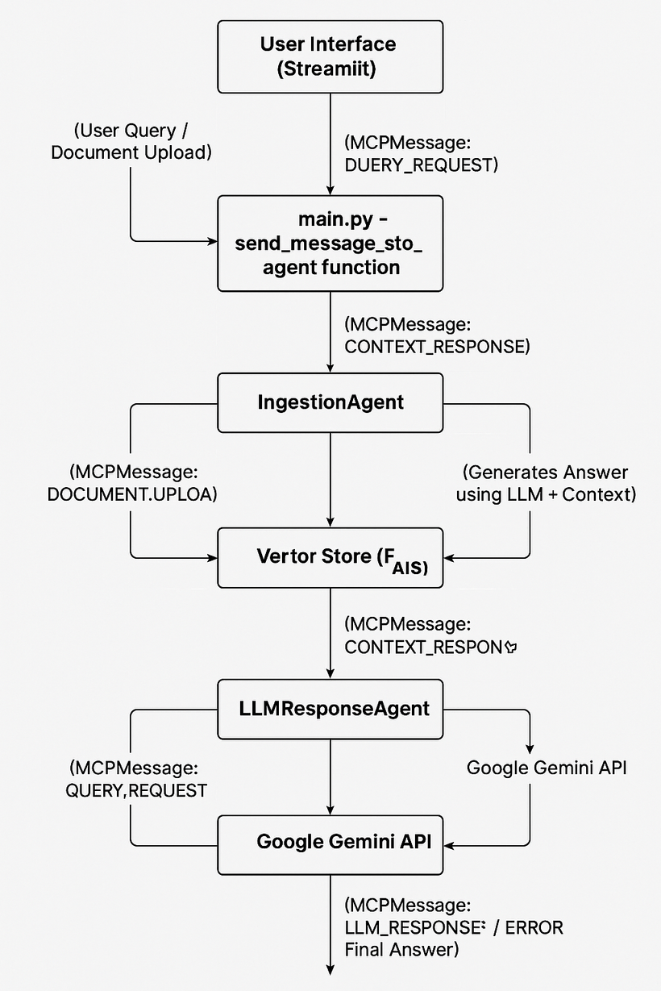

Slide 6
About
Contact
Tech Stack & UI Screenshots
Tech Stack Used:
Frontend/Web Framework: Streamlit (Python)
Agent Communication: Custom Model Context Protocol (MCP)
Vector Database: FAISS (Facebook AI Similarity Search)
Embeddings & LLM: Google Gemini API (google-generativeai library)
Document Parsing:
PyPDF2 (for PDFs)
python-docx (for DOCX)
pandas (for CSV)
python-pptx (for PPTX)
Standard Python file I/O (for TXT/MD)
Text Processing: sentence-transformers (for generating embeddings, implicitly used by google-generativeai or similar)
Environment Management: Python Virtual Environments (venv)
Version Control: Git / GitHub

Slide 7
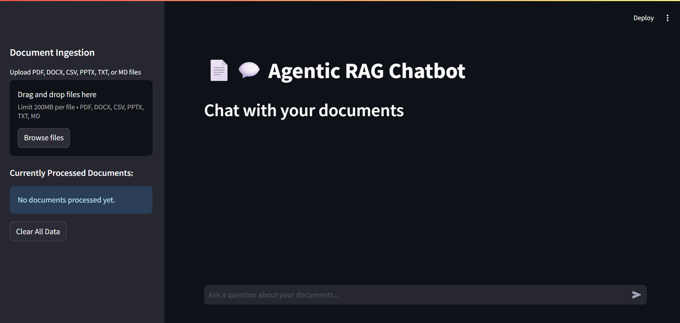
UI Screenshots of Working App:

Slide 8
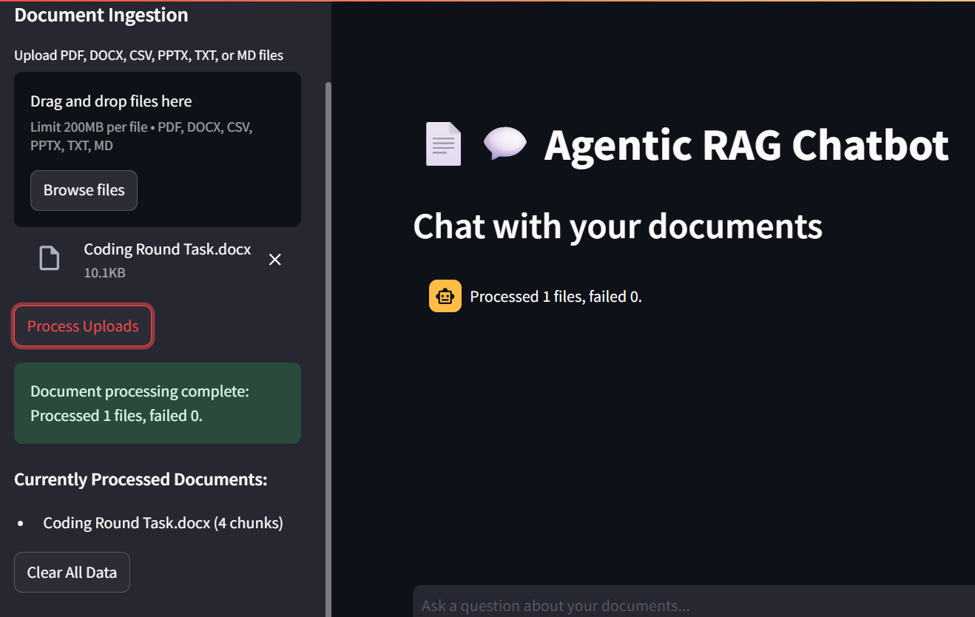

Slide 9
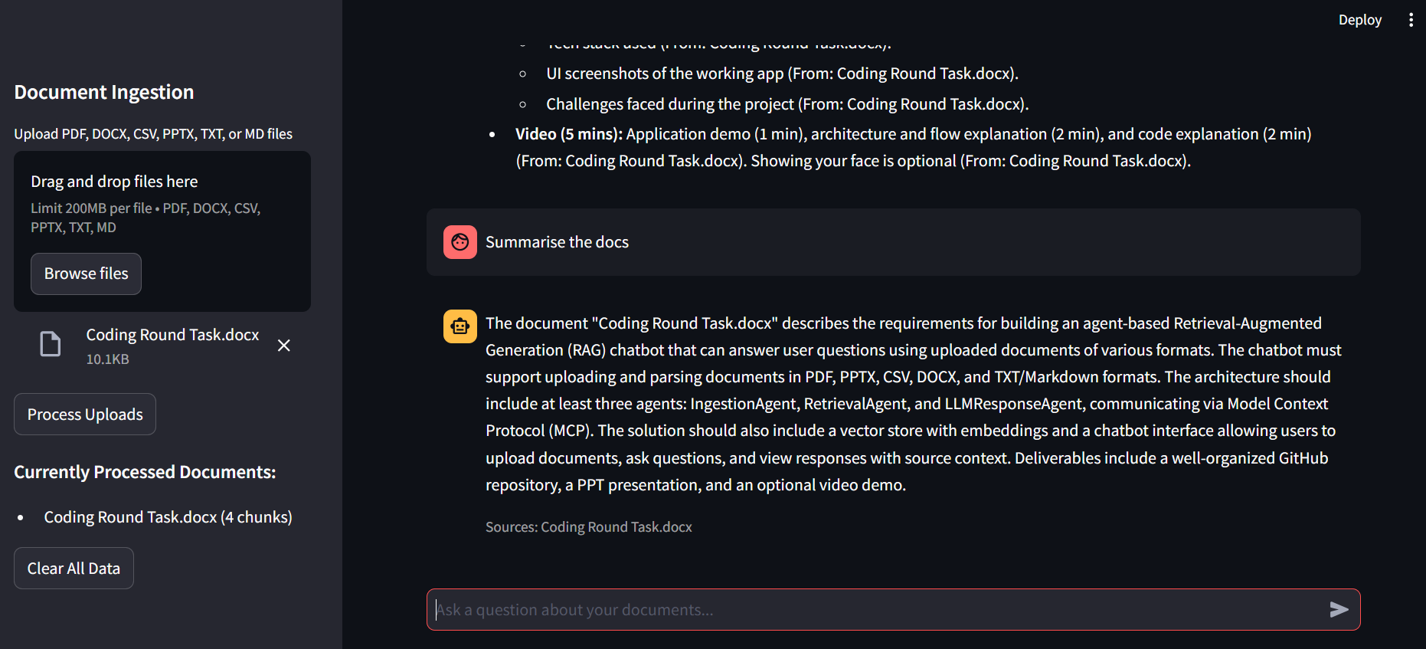

Slide 10
Studio Showe
About
Contact
Thank You

